Slide 1
Chapter 2
Reporting Investing and Financing Results on the Balance Sheet
Notes:
Chapter 2: Reporting Investing and Financing Results on the Balance Sheet

Slide 2
Building a Balance Sheet
Assets
resources of the business that generate future economic benefit.
=
Liabilities
amounts presently owed by a business to creditors.
+
Stockholders’ Equity
the amount invested and reinvested in a company by its shareholders. (“owned”)
2-<number>
Notes:
The balance sheet is structured like the basic accounting equation: Assets = Liabilities + Stockholders’ Equity. Assets are resources presently owned by a business that generate future economic benefit; liabilities are amounts presently owned by a business to creditors; and stockholders’ equity is the amount invested and reinvested in a company by its shareholders.

Slide 3

The Accounting Equation
A transaction is a business activity that affects the basic accounting equation.
Duality of Effects
Every transaction has at least two effects on the basic accounting equation.
2-<number>
Notes:
Part I
After having analyzed each transaction, a systematic accounting process is used to capture and report their financial effects. This process encompasses three basic steps: Analyze, Record, and Summarize.
Part II
A transaction is an exchange or an event that has a direct economic effect on the assets, liabilities, or stockholders’ equity of a business. Business activities that do not have direct or measurable financial effects on the company are not recorded in the accounting system.
When analyzing transactions, two simple ideas are used. The first idea is the duality of effects and the second is the basic accounting equation.
Duality of effects means that every transaction has a least two effects on the basic accounting equation. You already know the basic accounting equation. Just remember that the dollar amount for assets must always equal the total of liabilities plus stockholders’ equity for every accounting transaction.

Slide 4
Step 1: Analyze Transactions
2-<number>
Notes:
A summary of account names and corresponding account numbers is called a chart of accounts. Each company keeps a chart of accounts to ensure consistency in reporting its own financial results. Don’t try to memorize the chart of accounts. It is provided merely as a learning tool for you to see many of the common account titles you will be using in this class.
The accounts listed on this slide are just accounts used on the balance sheet of Pizza Aroma, our example company. Asset accounts start with the number 1, liability accounts start with the number 2, and Stockholders’ Equity accounts start with the number 3.

Slide 5

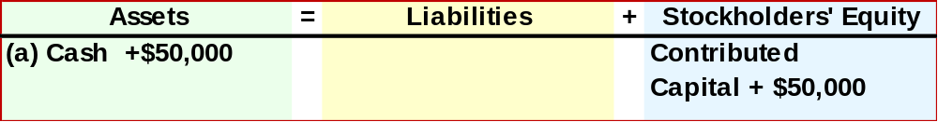
Step 1: Analyze Transactions
(a) Issue Stock to Owners.
Mauricio Rosa incorporates Pizza Aroma Inc., on August 1. The company issues stock to Mauricio and his wife as evidence of their contribution of $50,000 cash, which is deposited in the company’s bank account.
Pizza Aroma receives $50,000 Cash.
Pizza Aroma gives $50,000 Stock (Contributed Capital).
2-<number>
Notes:
Part I
Mauricio Rosa incorporates Pizza Aroma Inc., on August 1. The company issues stock to Mauricio and his wife as evidence of their contribution of $50,000 cash, which is deposited in the company’s bank account.
Part II
Pizza Aroma receives $50,000 cash and gives $50,000 of stock (contributed capital) in the transaction.
Part III
For this transaction, Cash, an asset, increases by $50,000 received from the owner. Stockholders’ equity increased by $50,000 when the stock was issued to Mauricio Rosa.

Slide 6
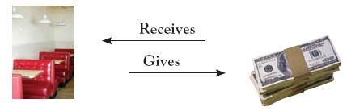
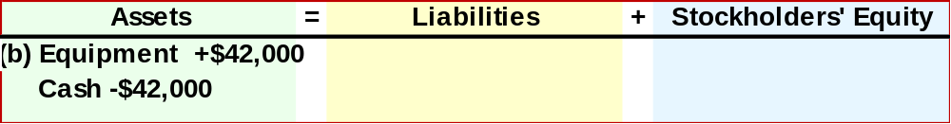
Step 1: Analyze Transactions
(b) Investment in Equipment.
Pizza Aroma pays $42,000 cash to buy restaurant booths and other equipment.
Pizza Aroma receives $42,000 of Equipment.
Pizza Aroma gives $42,000 Cash.
2-<number>
Notes:
Part I
Next, Pizza Aroma pays $42,000 cash to buy restaurant booths and other equipment.
Part II
Pizza aroma receives $42,000 of equipment for the restaurant and gives $42,000 cash.
Part III
For this transaction, Equipment is increased by $42,000 and the asset, Cash, is decreased by $42,000. Notice that is no impact on the Liabilities and Stockholders’ Equity section of the balance sheet. The company exchanged one asset cash for another asset equipment.

Slide 7
Learning Objective 3
Use journal entries and
T-accounts to show how transactions affect the balance sheet.
2-<number>
Notes:
Learning objective 3 is to use journal entries and T-accounts to show how transactions affect the balance sheet.

Slide 8
Step 2 and 3: Record and Summarize
Step 2 and 3: Journalize and Post
2-<number>
Notes:
Most companies use computerized accounting systems, which can handle a large number of transactions. These systems follow a cycle, called the accounting cycle, which is repeated day-after-day, month-after-month, and year-after-year.
A three-step analyze-record-summarize process is applied to daily transactions and then
to adjustments and closing processes at the end of each accounting period. Our focus
in this chapter is on applying the three-step process during the period to daily activities that affect only balance sheet accounts. The analyze step involves determining the financial effects of each transaction; the record step captures these effects in an accounting record called the journal; and the summarize step accumulates these effects in accounting records called ledger accounts or T-accounts.

Slide 9
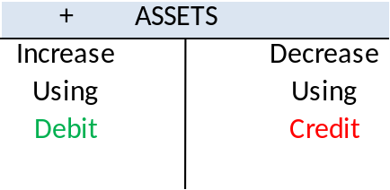
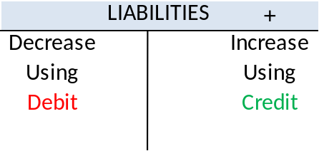
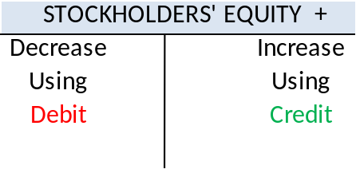

The Debit/Credit Framework
ASSETS = LIABILITIES + STOCKHOLDERS’ EQUITY
Asset accounts increase on the left or debit side and decrease on the right or credit side.
Liability accounts increase on the right or credit side and decrease on the left or debit side.
Stockholders’ equity accounts increase on the right or credit side and decrease on the left or debit side.
2-<number>
Notes:
Part I
Accounts increase on the same side as they appear in A = L + SE.
Part II
Accounts on the left side of the accounting equation increase on the left side of the account and accounts on the right side of the equation increase on the right. So
• Assets increase on the left side of the account.
Part III
• Liabilities increase on the right side of the account.
• Stockholders’ equity accounts increase on the right.
• Decreases are the opposite.
Part IV
Left is debit ( dr ), right is credit ( cr ). The terms (and abbreviations) debit ( dr ) and credit ( cr ) come from Latin words that had meaning back in the day, but today they just mean left and right. When combined with how increases and decreases are entered into accounts, the following rules emerge:
Use debits for increases in assets (and for decreases in liabilities and stockholders’ equity accounts).
Use credits for increases in liabilities and stockholders’ equity accounts (and for decreases in assets).

Slide 10




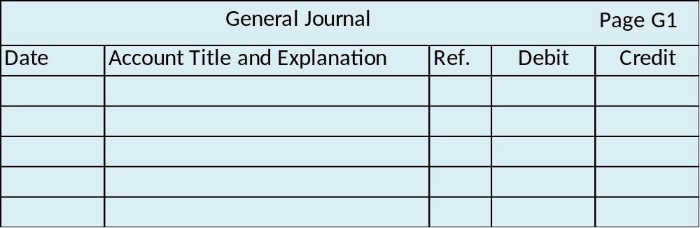

Steps 2 & 3: Record and Summarize
1
Analyze
2
Record
3
Summarize
2-<number>
Notes:
The debit-credit framework is the basis As we saw earlier, first transactions are analyzed to determine their financial effects. In step 2, these financial effects are recorded in a journal using a debits-equal-credits format. The journal entries are recorded in the order transactions occur, and then their effects on each individual account are summarized in step 3, to enable preparation of financial statements.

Slide 11
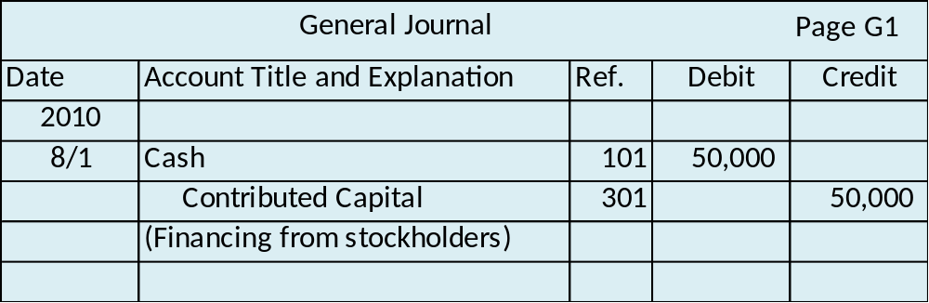
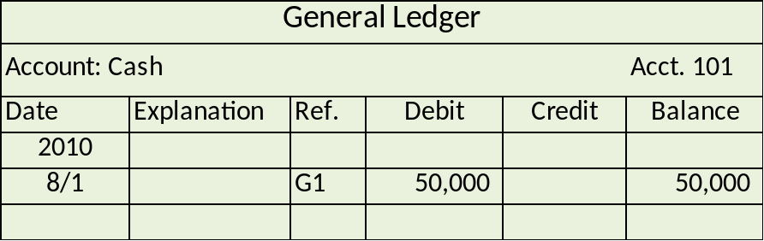
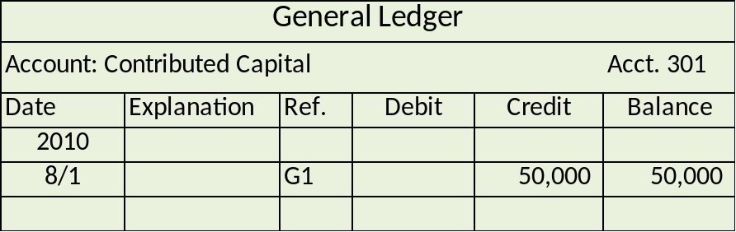
Steps 2 & 3: Record and Summarize
1
Analyze
2
Record
3
Summarize
2-<number>
Notes:
Part I
Notice the following aspects of journal entries in step 2.
A date is included for each transaction.
Debits appear first (on top). Credits are written below the debits and are indented to the right (both the words and the amounts). The order of the debited accounts or credited accounts doesn’t matter, as long as for each journal entry debits are on top and credits are on the bottom and indented.
Total debits equal total credits for each transaction.
Dollar signs are not used because the journal is understood to be a record of financial effects.
A brief explanation of the transaction is written below the debits and credits.
The line after the explanation is left blank before writing the next journal entry.
By themselves, journal entries show the effects of transactions, but they do not provide account balances. That’s why ledger accounts are needed.
Part II
After journal entries have been recorded (in step 2), their dollar amounts are copied (“posted”) to each ledger account affected by the transaction so that account balances can be computed. This step 3 involves copying the debit part of the journal entry into the debit column of the applicable ledger account and the credit part of the journal entry into the credit column of the other applicable ledger account.
The updated balance for each ledger account at the end of the accounting period will be used to prepare financial statements.

Slide 12
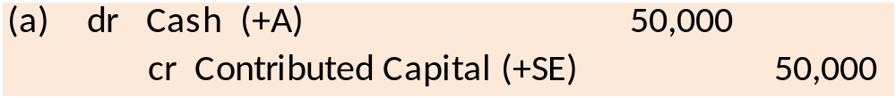
Steps 2 & 3: Record and Summarize
1
Analyze
2
Record
3
Summarize
2-<number>
Notes:
For classroom purposes, we use a simplified version of the journal entry. This simplified format includes a reference, such as the letter (a) shown here. The abbreviation dr is used for debit and cr is used for credit. The account name is shown, along with the effect of the journal entry on the accounting equation. In this example, a debit to cash causes an increase in assets and a credit to contributed capital causes an increase in stockholders’ equity. Finally, the amount is shown for each line of the journal entry. As shown earlier on the formal journal page, the credit line is indented to the right.

Slide 13
Steps 2 & 3: Record and Summarize
1
Analyze
2
Record
3
Summarize
2-<number>
Notes:
For classroom purposes, we will also use a simplified version of ledger accounts, called T-accounts. The name T-account comes from the appearance of the debit and credit columns represented in this simplified format.
Now let’s practice following these steps, with the transactions we previously analyzed for Pizza Aroma.

Slide 14


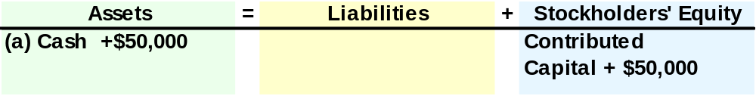




Pizza Aroma’s Accounting Records
(a) Issue Stock to Owners.
Mauricio Rosa incorporates Pizza Aroma Inc., on August 1. The company issues stock to Mauricio and his wife as evidence of their contribution of $50,000 cash, which is deposited in the company’s bank account.
1
Analyze
2
Record
3
Summarize
2-<number>
Notes:
Part I
Mauricio Rosa incorporates Pizza Aroma Inc., on August 1. The company issues stock to Mauricio and his wife as evidence of their contribution of $50,000 cash, which is deposited in the company’s bank account.
Part II
Analyze the transaction. In this case Cash, an asset, increased by $50,000, and Contributed Capital, a Stockholders’ Equity account increase by the same amount.
Part III
The general journal entry is to debit, or increase the asset Cash for $50,000, and credit, or increase, the stockholders’ equity account, Contributed Capital for the same amount.
Part IV
We summarize the transaction by posting the amount to the general ledger accounts. The Cash accounting will increase by $50,000, and the Contributed Capital accounting will also increase by the same amount. After the transaction is posted, the balance in the Cash account is $50,000.

Slide 15

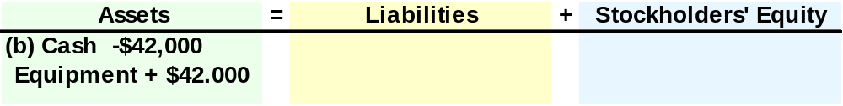

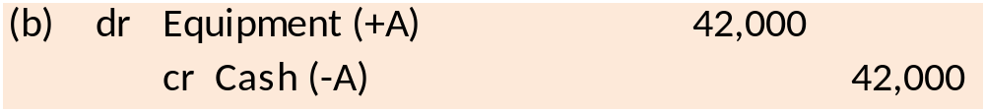



Pizza Aroma’s Accounting Records
(b) Investment in Equipment.
Pizza Aroma pays $42,000 cash to buy restaurant booths and other equipment.
1
Analyze
2
Record
3
Summarize
2-<number>
Notes:
Part I
Next, Pizza Aroma pays $42,000 cash to buy restaurant booths and other equipment.
Part II
Our analysis of this transaction indicates that the asset account Equipment increased by $42,000, and the asset account Cash decreased by $42,000.
Part III
The general journal entry to record the transaction is to debit, or increase, the equipment account by $42,000, and credit, or decrease, the asset account Cash for $42,000.
Part IV
Finally, we summarize the transactions by posting them to the general ledger. The credit to cash reduces the asset account by $42,000, and the asset account Equipment is increase by $42,000.

Slide 16
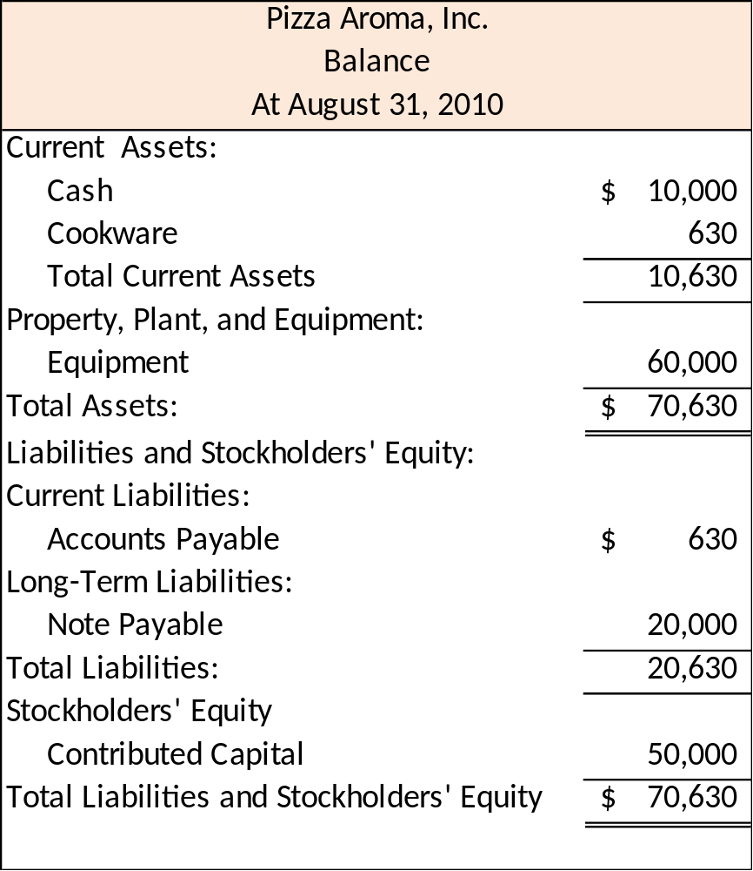
Classified Balance Sheet
2-<number>
Notes:
A classified balance sheet contains subcategories for assets and liabilities labeled current. Current assets are assets the business will use up or turn into cash within 12 months of the balance sheet date. Current liabilities are debts and other obligations that will be paid or fulfilled within 12 months of the balance sheet date. Equipment and Note Payable accounts, and stockholders’ equity accounts are understood to be long-term in nature. Retained Earnings account in stockholders’ equity despite its zero balance because we don’t want you to forget about this account.

Slide 17
Chapter 2
Solved Exercises
Notes:
Chapter 2 Solved Exercises: M2-13, M2-14, M2-15, M2-16, E2-4, E2-6

Slide 18

M2-13 Identifying Transactions and Preparing Journal Entries
J.K. Builders was incorporated in July. Prepare journal entries for the following events from the first month of business. If the event is not a transactions, write “no transaction.”
Received $55,000 cash invested by owners and issued stock.
Bought an unused field from a local farmer by paying $45,000 cash. As a construction site for smaller projects it is estimated to be worth $50,000 to J.K. Builders.
A lumber supplier delivered lumber to J.K. Builders for future use. The lumber would have normally sold for $10,000, but the supplier gave J.K. Builders a 10% discount. J.K. Builders has not received a bill from the suppliers.
dr Cash (+A) 55,000
cr Contributed Capital (+SE) 55,000
b. dr Inventory (+A) 45,000
cr Cash (-A) 45,000
c. dr Supplies (+A) 9,000
cr Accounts Payable (+L) 9,000
$10,000 × 10% = $1,000; $10,000 - $1,000 = $9,000
2-<number>
Notes:
Part I
J.K. Builders was incorporated on July 1, 2010. Prepare journal entries for the following events from the first month of business. If the event is not a transactions, write “no transaction.”
Received $55,000 cash invested by owners and issued stock.
Bought an unused field from a local farmer by paying $45,000 cash. As a construction site for smaller projects it is estimated to be worth $50,000 to J.K. Builders.
A lumber supplier delivered lumber to J.K. Builders for future use. The lumber would have normally sold for $10,000, but the supplier gave J.K. Builders a 10% discount. J.K. Builders has not received a bill from the suppliers.
Part II
For part (a) we begin by debiting, or increasing the asset account Cash for $55,000.
Part III
The second part of the entry is to credit, or increase, the stockholders’ equity account Contributed Capital for $55,000.
Part IV
For part (b) or the problem, we begin with a debit, or increase, in the asset account Inventory for $45,000.
Part V
The final part of the entry is to credit, or decrease, the asset accounting Cash for $45,000.
Part VI
For part (c) of the problem, we begin with a debit, or increase, in the asset account Supplies for $9,000.
Part VII
We complete the entry with a credit, or decrease, in the asset account Cash for $9,000. You can see that the $9,000 is calculated by subtracting the $1,000 discount from the gross amount of $10,000, to arrive at the net amount due of $9,000.

Slide 19

M2-13 Identifying Transactions and Preparing Journal Entries
Borrowed $25,000 from the bank with a plan to use the funds to build a small workshop in August. The loan must be report in two years.
One of the owners sold $10,000 worth of his stock to another shareholder for $11,000 cash.
dr Cash (+A) 25,000
cr Notes Payable (+L) 25,000
e. No transaction
Event (e) is a transaction between two independent individuals and does not involve the company, J.K. Builders.
2-<number>
Notes:
Part I
This is a continuation of the problem we started on the previous screen.
Borrowed $25,000 from the bank with a plan to use the funds to build a small workshop in August. The loan must be report in two years.
One of the owners sold $10,000 worth of his stock to another shareholder for $11,000 cash.
Part II
We begin recording transaction (d) with a debit, or increase, in the asset account Cash for $25,000.
Part III
We complete the recording with a credit, or increase, to the liability account Notes Payable for $25,000.
Part IV
Section (e) of the problem is really not a transaction between the company and an outside party. Rather it is a transaction between two individuals and does not impact the records of J. K. Builders.

Slide 20

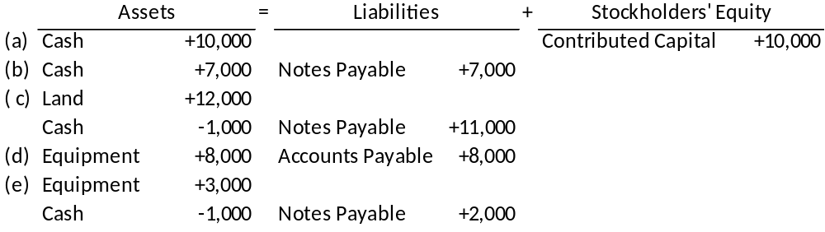
E2-4 Determining Financial Statement Effects of Several Transactions
The following events occurred for Favata Company:
a. Received $10,000 cash from owners and issued stock to them.
b. Borrowed $7,000 cash from a bank and signed a note.
c. Purchased land for $12,000; paid $1,000 in cash and signed a note for the balance.
d. Bought $8,000 of equipment on account.
e. Purchased $3,000 of equipment, paying $1,000 in cash and signing a note for the rest.
2-<number>
Notes:
Part I
E2-4
The following events occurred for Favata Company:
a. Received $10,000 cash from owners and issued stock to them.
b. Borrowed $7,000 cash from a bank and signed a note.
c. Purchased land for $12,000; paid $1,000 in cash and signed a note for the balance.
d. Bought $800 of equipment on account.
e. Purchased $3,000 of equipment, paying $1,000 in cash and signing a note for the rest.
Required:
For each of the events ( a) through ( e), perform transaction analysis and indicate the account amount, and direction of the effect ( for increase and for decrease) on the accounting equation. Check that the accounting equation remains in balance after each transaction. Use the following
Headings of Assets = Liabilities + Stockholders’ Equity
In transaction (a) we have an increase in the asset Cash for $10,000, and an increase in Contributed Capital for the same amount.
Part II
In transaction (b) we have an increase in the asset Cash for $7,000, and an increase in the liability Notes Payable for the same amount.
Part III
For transaction (c) we have an increase in the asset Land for $12,000, a decrease in the asset Cash for $1,000, and an increase in Notes Payable for $11,000.
Part IV
In transaction (d) we have an increase in the asset account Equipment for $800, and an increase in the liability account, Accounts Payable for the same amount.
Part V
Finally, in transaction (e) we have an increase in the asset Equipment for $3,000, a decrease in the asset Cash for $1,000, and an increase in the liability account Notes Payable for $2,000.

Slide 21
End of Chapter 2
Notes:
End of chapter 2.

